Slide 1

Cluster analysis

Slide 2
What is Cluster analysis?
Cluster analysis is a group of multivariate techniques whose primary purpose is to group objects (e.g., respondents, products, or other entities) based on the characteristics they possess.
It is a means of grouping records based upon attributes that make them similar. If plotted geometrically, the objects within the clusters will be close together, while the distance between clusters will be farther apart.

Slide 3
Objectives of cluster analysis
Cluster analysis used for:
Taxonomy Description. Identifying groups within the data
Data Simplification. The ability to analyze groups of similar observations instead all individual observation.
Relationship Identification. The simplified structure from CA portrays relationships not revealed otherwise.
Theoretical, conceptual and practical considerations must be observed when selecting clustering variables for CA:
Only variables that relate specifically to objectives of the CA are included.
Variables selected characterize the individuals (objects) being clustered.

Slide 4
How does Cluster Analysis work?
The primary objective of cluster analysis is to define the structure of the data by placing the most similar observations into groups. To accomplish this task, we must address three basic questions:
How do we measure similarity?
How do we form clusters?
How many groups do we form?

Slide 5
Measuring Similarity
Similarity represents the degree of correspondence among objects across all of the characteristics used in the analysis. It is a set of rules that serve as criteria for grouping or separating items.
Correlational measures.
Less frequently used, where large values of r’s do indicate similarity
Distance Measures.
Most often used as a measure of similarity, with higher values representing greater dissimilarity (distance between cases), not similarity.

Slide 6

Similarity Measure
Both graph have the same r = 1, which implies to have a same pattern. But the distances (d’s) are not equal.
Graph 1 represents higher level of similarity

Slide 7


Distance Measures
Several distance measures are available, each with specific characteristics.
Euclidean distance. The most commonly recognized to as straight- line distance.
Squared Euclidean distance. The sum of the squared differences without taking the square root.
City- block (Manhattan) distance. Euclidean distance. Uses the sum of the variables’ absolute differences

Slide 8
Distance Measures
Chebychev distance. Is the maximum of the absolute difference in the clustering variables’ values. Frequently used when working with metric (or ordinal) data.
Mahalanobis distance (D2). Is a generalized distance measure that accounts for the correlations among variables in a way that weights each variables equally.

Slide 9
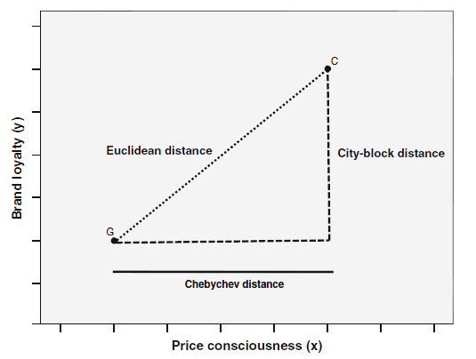
Illustration:

Slide 10
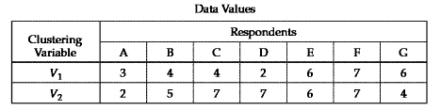
Simple Example
Suppose a marketing researcher wishes to determine market segments in a community based on patterns of loyalty to brands and stores a small sample of seven respondents is selected as a pilot test of how cluster analysis is applied. Two measures of loyalty- V1(store loyalty) and V2(brand loyalty)- were measured for each respondents on 0-10 scale.

Slide 11
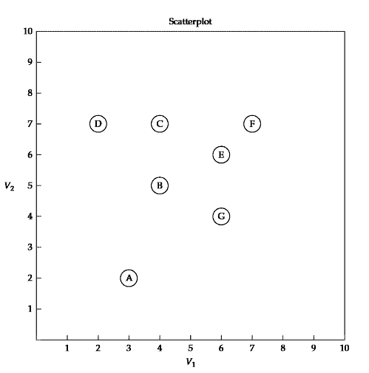
Simple Example

Slide 12

Proximity Matrix of Euclidean Distance Between Observations
Observation | Observations
 | A | B | C | D | E | F | G
A | ---
B | 3.162 | ---
C | 5.099 | 2.000 | ---
D | 5.099 | 2.828 | 2.000 | ---
E | 5.000 | 2.236 | 2.236 | 4.123 | ---
F | 6.403 | 3.606 | 3.000 | 5.000 | 1.414 | ---
G | 3.606 | 2.236 | 3.606 | 5.000 | 2.000 | 3.162 | ---

Slide 13
How do we form clusters?
SIMPLE RULE:
Identify the two most similar(closest) observations not already in the same cluster and combine them.
We apply this rule repeatedly to generate a number of cluster solutions, starting with each observation as its own “cluster” and then combining two clusters at a time until all observations are in a single cluster. This process is termed a hierarchical procedure because it moves in a stepwise fashion to form an entire range of cluster solutions. It is also an agglomerative method because clusters are formed by combining existing clusters

Slide 14
How do we form clusters?
AGGLOMERATIVE PROCESS |  |  | CLUSTER SOLUTION
Step | Minimum Distance Unclustered Observationsª | Observation Pair | Cluster Membership | Number of Clusters | Overall Similarity Measure (Average Within-Cluster Distance)
 | Initial Solution |  | (A)(B)(C)(D)(E)(F)(G) | 7 | 0
1 | 1.414 | E-F | (A)(B)(C)(D)(E-F)(G) | 6 | 1.414
2 | 2.000 | E-G | (A)(B)(C)(D)(E-F-G) | 5 | 2.192
3 | 2.000 | C-D | (A)(B)(C-D)(E-F-G) | 4 | 2.144
4 | 2.000 | B-C | (A)(B-C-D)(E-F-G) | 3 | 2.234
5 | 2.236 | B-E | (A)(B-C-D-E-F-G) | 2 | 2.896
6 | 3.162 | A-B | (A-B-C-D-E-F-G) | 1 | 3.420
In steps 1,2,3 and 4, the OSM does not change substantially, which indicates that we are forming other clusters with essentially the same heterogeneity of the existing clusters.
When we get to step 5, we see a large increase. This indicates that joining clusters (B-C-D) and (E-F-G) resulted a single cluster that was markedly less homogenous.

Slide 15
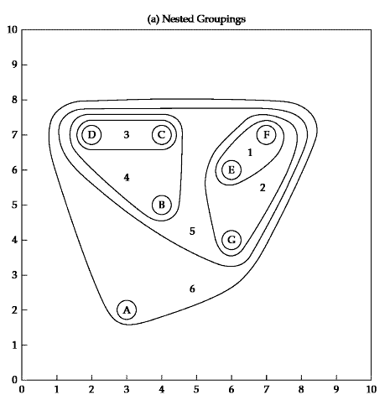
Graphical Portrayals

Slide 16
Outliers: Removed or Retained?
Outliers can severely distort the representativeness of the results if they appear as structure (clusters) inconsistent with the objectives.
They should be removed if the outliers represents:
Abberant observations not representative of the population
Observations of small or insignificant segments within the population and of no interest to the research objectives
They should be retained if a undersampling/poor representation of relevant groups in the population; the sample should be augmented to ensure representation of these group.

Slide 17
Hierarchical Cluster Analysis

Slide 18
Hierarchical Cluster Analysis
The stepwise procedure attempts to identify relatively homogeneous groups of cases based on selected characteristics using an algorithm either agglomerative or divisive, resulting to a construction of a hierarchy or treelike structure (dendogram) depicting the formation of clusters. This is one of the most straightforward method.
HCA are preferred when:
The sample size is moderate (under 300 – 400, not exceeding 1000).

Slide 19
Two Basic Types of HCA
Agglomerative Algorithm
Divisive Algorithm
Algorithm- defines how similarity is defined between multiple member clusters in the clustering process.

Slide 20
Agglomerative Algorithm
Hierarchical procedure that begins with each object or observation in a separate cluster. In each subsequent step, the two clusters that are most similar are combined to build a new aggregate cluster. The process is repeated until all objects a finally combined into a single clusters. From n clusters to 1.
Similarity decreases during successive steps. Clusters can’t be split.

Slide 21
Divisive Algorithm
Begins with all objects in single cluster, which is then divided at each step into two additional clusters that contain the most dissimilar objects. The single cluster is divided into two clusters, then one of these clusters is split for a total of three clusters. This continues until all observations are in a single – member clusters. From 1 cluster to n sub clusters

Slide 22
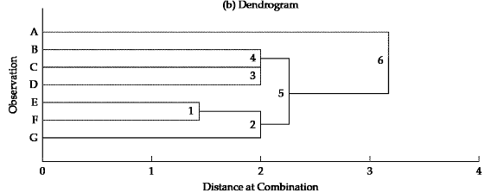
Dendogram/ Tree Graph
Divisive Method
Aglomerative Method

Slide 23
Agglomerative Algorithms
Among numerous approaches, the Five most popular agglomerative algorithms are:
Single – Linkage
Complete – Linkage
Average – Linkage
Centroid Method
Ward’s Method

Slide 24
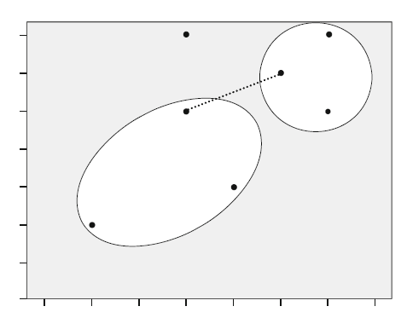
Agglomerative Algorithms
Single – Linkage
Also called the nearest – neighbor method, defines similarity between clusters as the shortest distance from any object in one cluster to any object in the other.

Slide 25
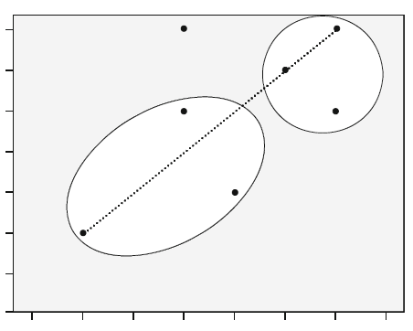
Agglomerative Algorithms
Complete Linkage
Also known as the farthest – neighbor method.
The oppositional approach to single linkage assumes that the distance between two clusters is based on the maximum distance between any two members in the two clusters.

Slide 26
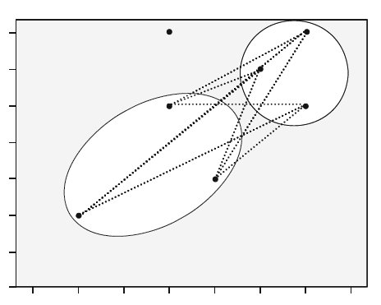
Agglomerative Algorithms
Average Linkage
The distance between two clusters is defined as the average distance between all pairs of the two clusters’ members

Slide 27
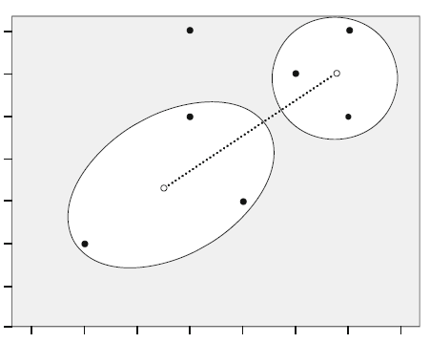
Agglomerative Algorithms
Centroid Method
Cluster Centroids are the mean values of the observation on the variables of the cluster.
The distance between the two clusters equals the distance between the two centroids.

Slide 28
Agglomerative Algorithms
Ward’s Method
The similarity between two clusters is the sum of squares within the clusters summed over all variables.
Ward's method tends to join clusters with a small number of observations, and it is strongly biased toward producing clusters with the same shape and with roughly the same number of observations.

Slide 29
Hierarchical Cluster Analysis
The Hierarchical Cluster Analysis provides an excellent framework with which to compare any set of cluster solutions.
This method helps in judging how many clusters should be retained or considered.

Slide 30
K-means Cluster Analysis

Slide 31
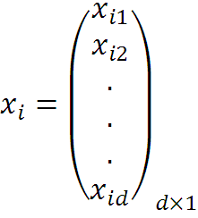


Consider a Set of Data Points,
And a Set of Clusters,

Slide 32
Algorithm k-means
1. Randomly choose K data items from X as initial centroids.
2. Repeat
Assign each data point to the cluster which has the closest centroid.
Calculate new cluster centroids.
Until the convergence criteria is met.

Slide 33
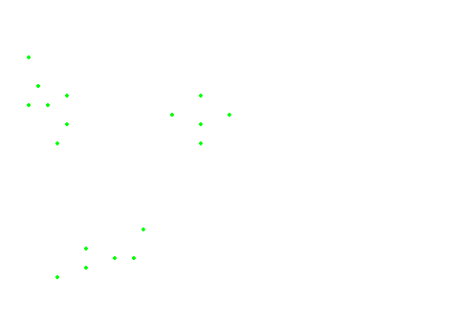
The data points

Slide 34
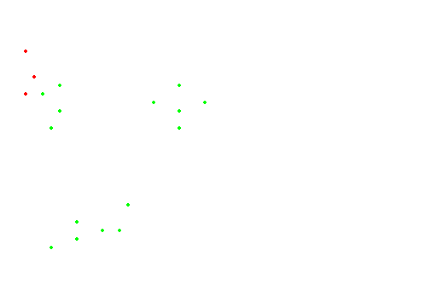
Initialization

Slide 35
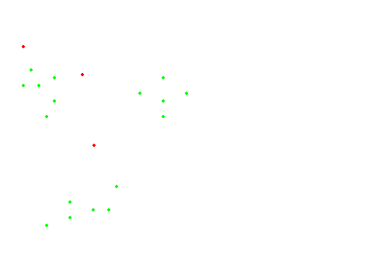
#Runs = 1

Slide 36
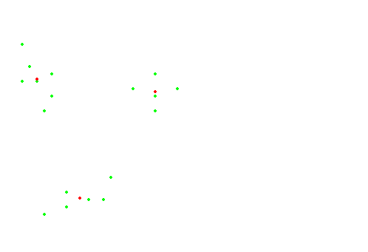
#Runs = 2

Slide 37
#Runs = 3
K-means gets stuck in a local optima

Slide 38
Applications of K-means Method
Optical Character Recognition
Biometrics
Diagnostic Systems
Military Applications

Slide 39
Comments on the K-Means Method
Strength
Relatively efficient: O(tkn), where n is # objects, k is # clusters, and t is # iterations. Normally, k, t << n.
Often terminates at a local optimum. The global optimum may be found using techniques such as: deterministic annealing and genetic algorithms
Weakness
Applicable only when mean is defined, then what about categorical data?
Need to specify k, the number of clusters, in advance
Unable to handle noisy data and outliers
Not suitable to discover clusters with non-convex shapes

